Slide 1



STUDENT SEGMENTATION
BY CHOY JEE HUNG CALEB P2341475

Slide 2

TABLE OF CONTENT
1
2
3
Data Exploration
Data Preprocessing
Model building
4
5
6
Model Improvements
Cluster
Evaluation
Results & Conclusion

Slide 3
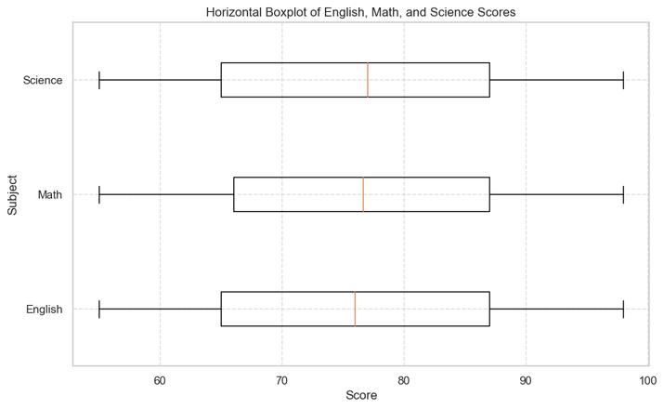
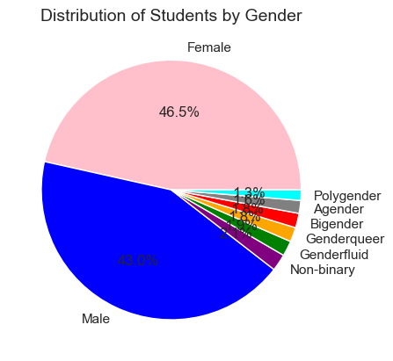
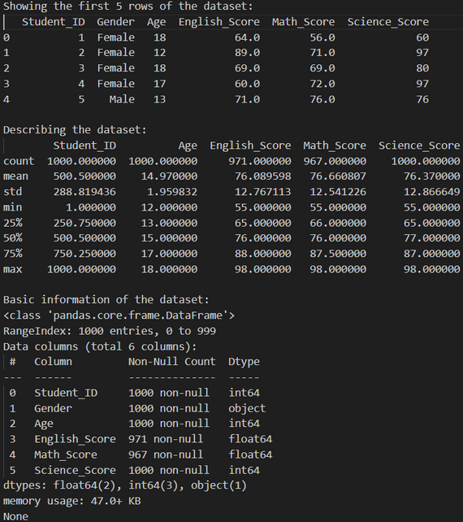
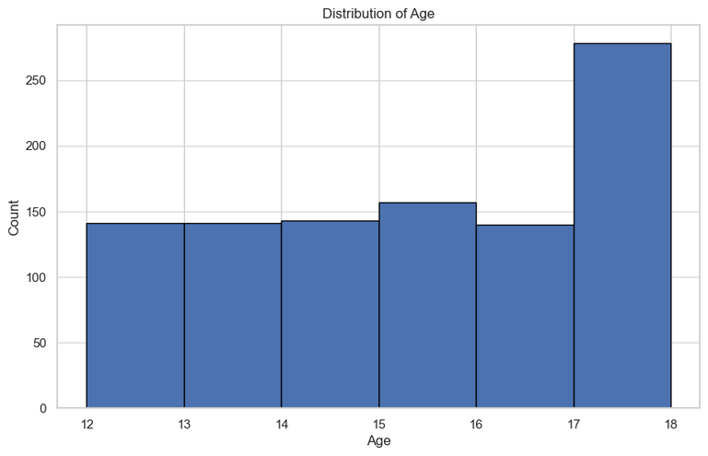
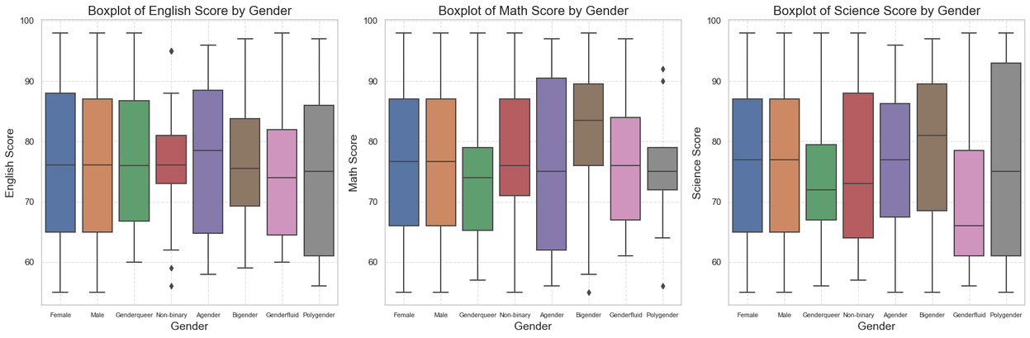
Univariate Analysis:
Data Exploration
View the dataset:
Bivariate Analysis:

Slide 4
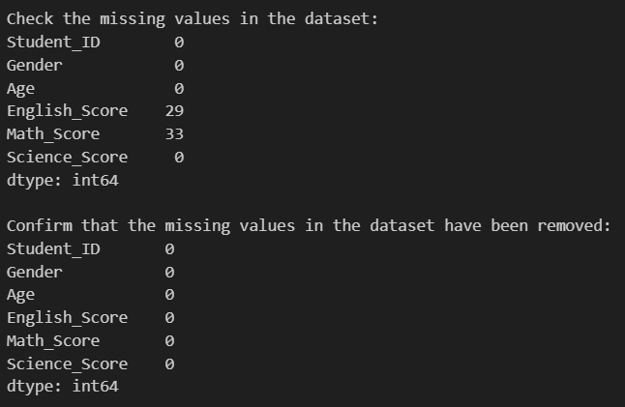
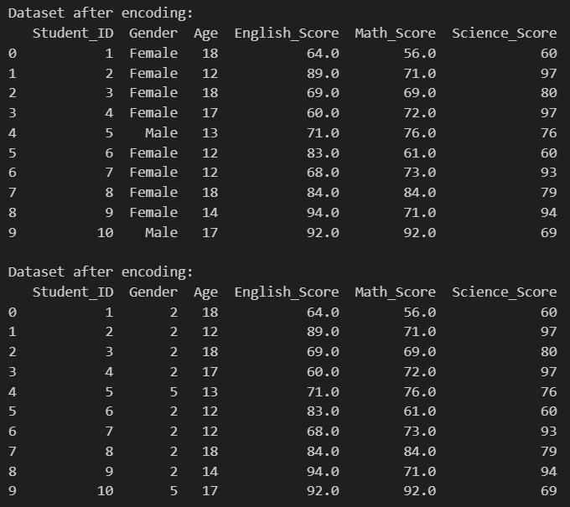
Data Preprocessing-Cleaning
Removing NaN values:
Removing categorical features with encoding:

Slide 5
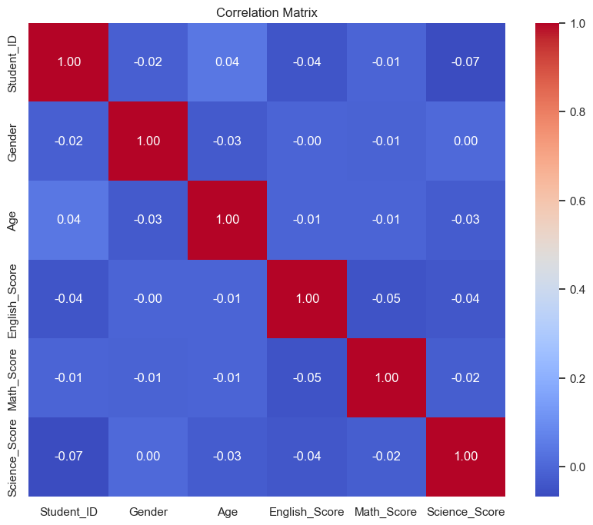
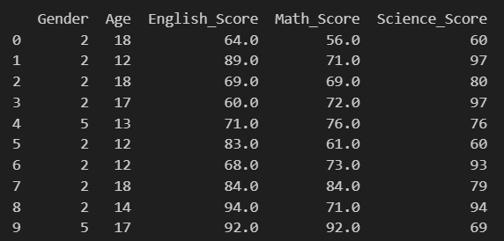
Data Preprocessing-Cleaning
Univariate Analysis:
1 indicates a perfect positive correlation
-1 indicates a perfect negative correlation
0 indicates no correlation
From this matrix, we can see that student ID does not have a correlation with scores, therefore we are going to drop the column.
Dropping of student_id column:

Slide 6
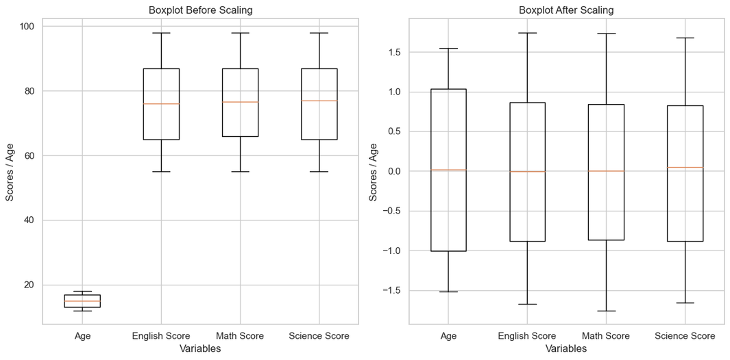
Data Preprocessing-Standardize
Z-Score Standardization (Standard Scaler)
This is good for preserving the original distribution and shape.
Gives Gaussian Distribution
Min-Max Scaling
Useful when wanting to preserve the relationships between data points.
Cannot handle outliers.
We will be using standard scaler in this case as our data has many outliers according to EDA.

Slide 7
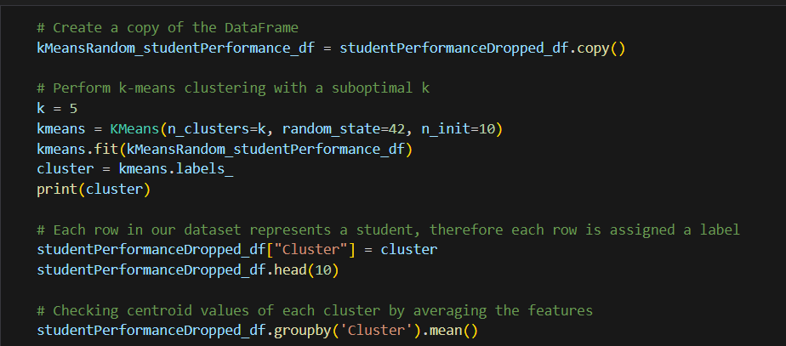
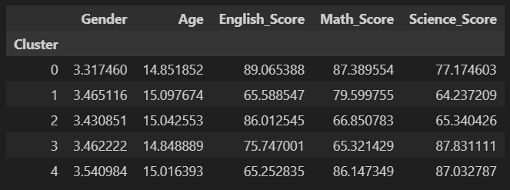
Model Building - kmeans random k value
I first do on a random k cluster on kmeans to test output:

Slide 8
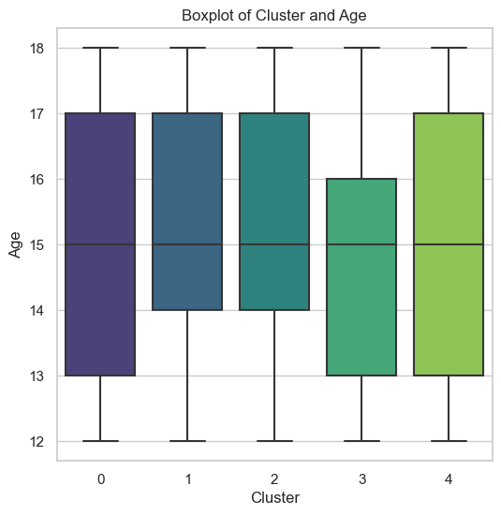
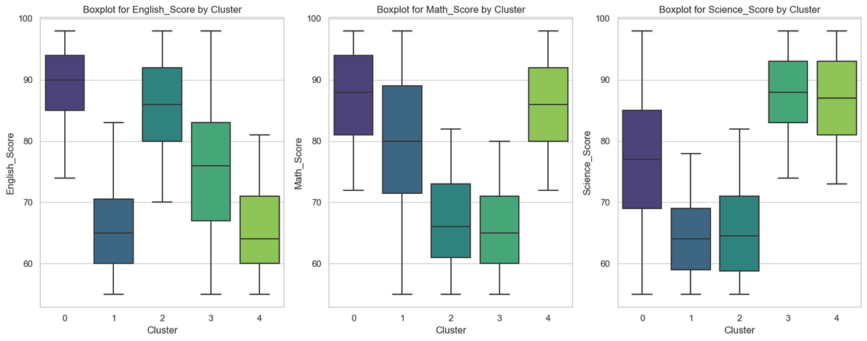
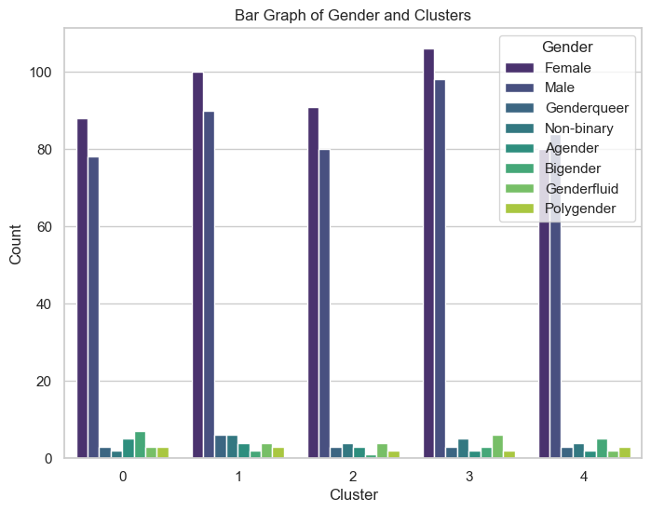
Model Building - Visualizing
Age and cluster:
Score and cluster:
Genders with cluster:

Slide 9
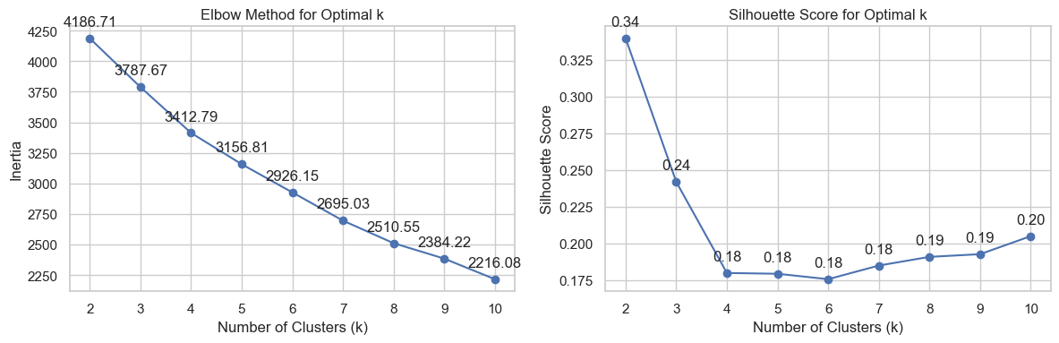
Model Improvements- Silhouette/Intertia
A better Silhouette score indicates better separation, and generally means a better model.
A lower inertia score indicates a better defined cluster, and generally a better model.
We can see that Inertia decreases with the amount of clusters, while the Silhouette coefficient increases and peaks at 2 clusters. Then it decreases towards 6 clusters, and increases again towards 10 clusters.
Even though the silhouette score at 2 is higher that at 3, it has a significantly lower Inertia score. Thus I will be going with 3 clusters.

Slide 10
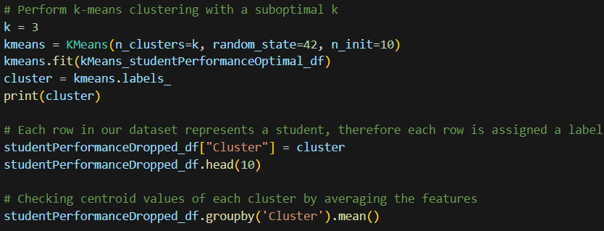
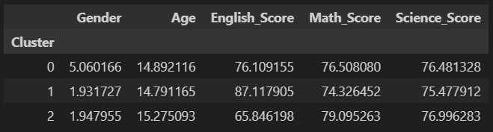
Model Building - Optimal k value
I will now do k-cluster of 3:

Slide 11
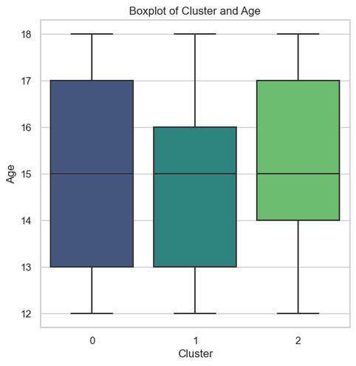
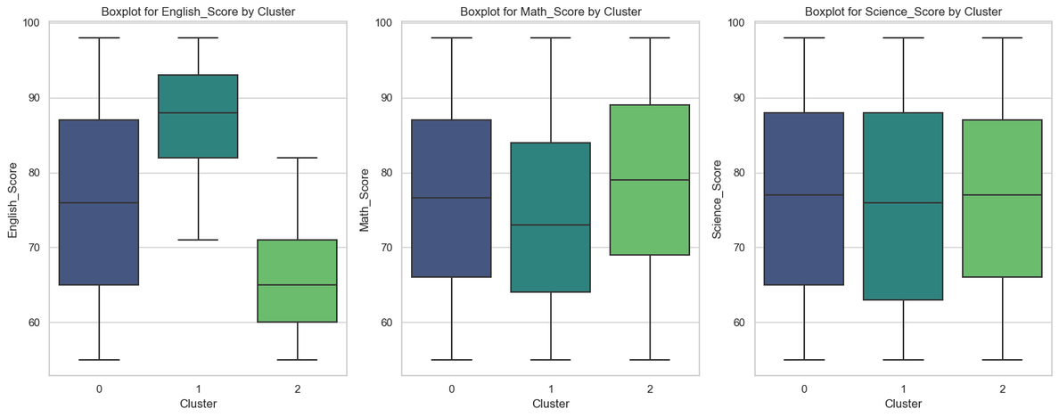
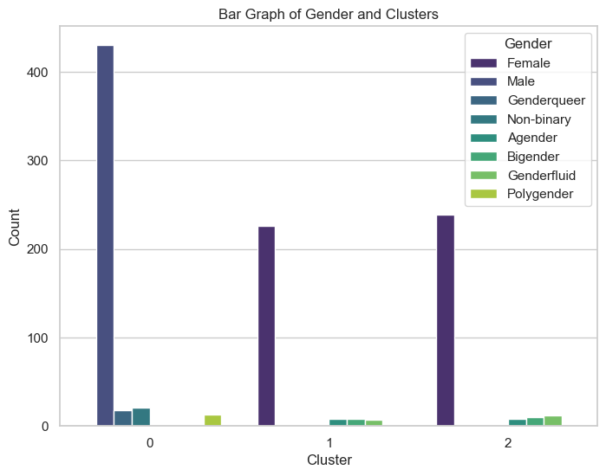
Model Building - Visualizing
Age and cluster:
Score and cluster:
Gender and cluster:

Slide 12
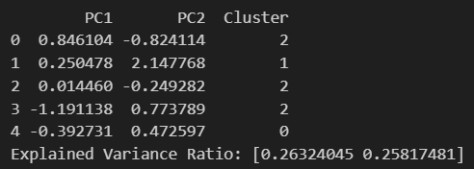
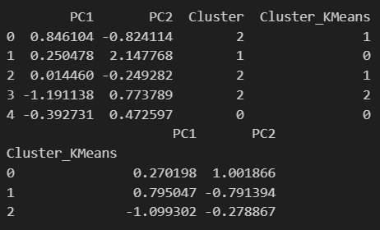
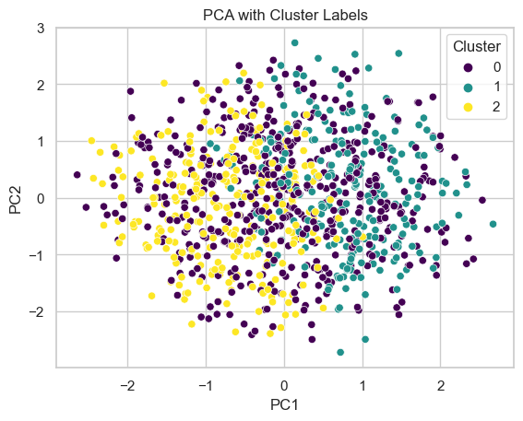
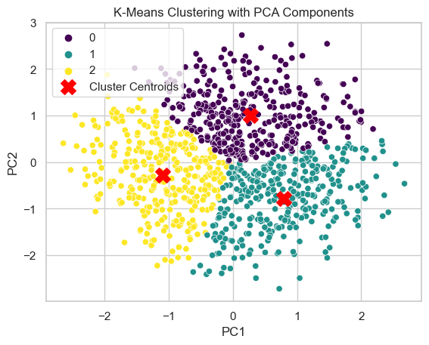
Model Improvements- Dimension Reduce
Explanation:
The first table indicates the coordinates of each data point after dimensionality reduction and its cluster assignments obtained from two different clustering methods: one unspecified method and K-means clustering.
The second table provides the mean values of PC1 and PC2 for each cluster identified by K-means clustering.
Interpretation:
The first table gives a snapshot of the data points in the reduced feature space along with their cluster assignments from two different clustering methods.
The second table provides additional insight into the characteristics of the clusters identified by K-means, showing the average values of PC1 and PC2 for each cluster.
This information helps in understanding the distribution of data points in the reduced feature space and the characteristics of clusters identified by different clustering methods.

Slide 13
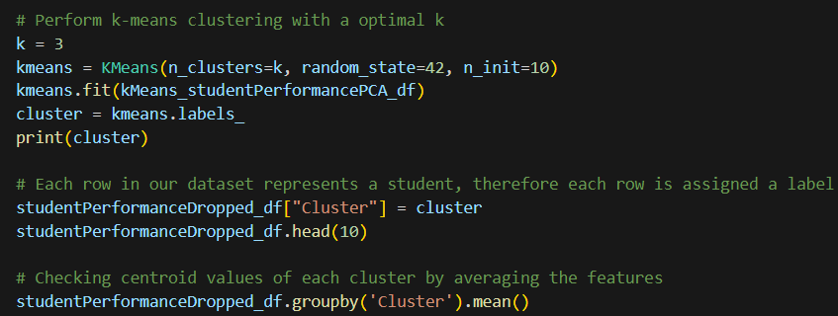
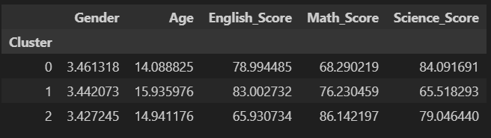
Model Building - Optimal k with PCA
I will now do k-cluster of 3 with the PCA data:

Slide 14
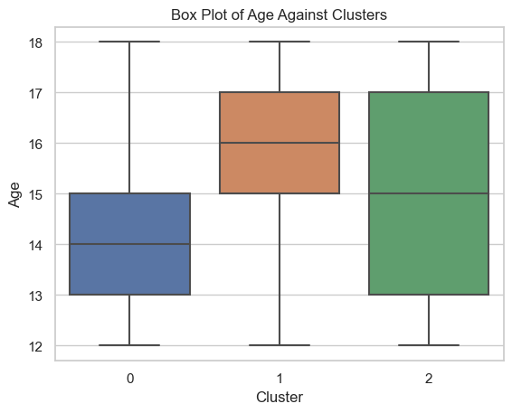
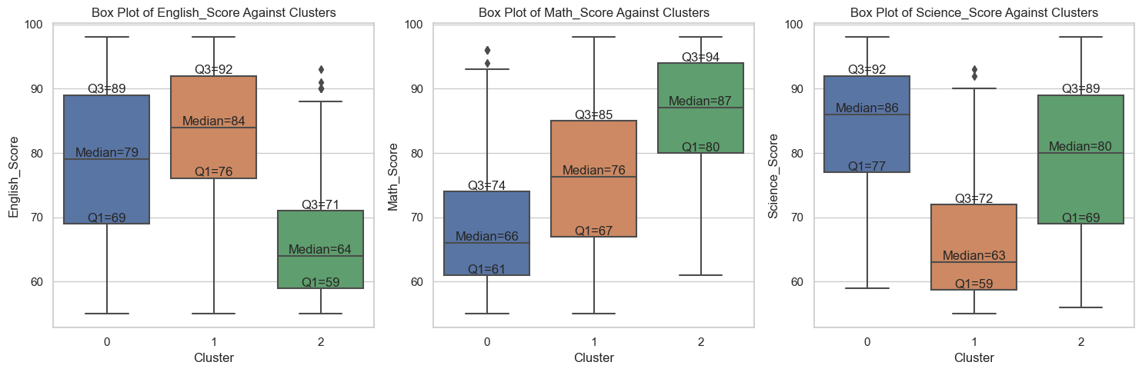
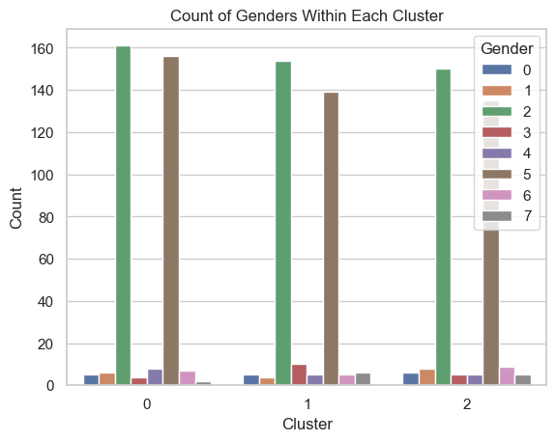
Model Building - Visualizing
Age and cluster:
Score and cluster:
Cluster 0:
- Mix of males and females
- Age range of 13-15
- English score of 69-89 with a median of 79
- Math score of 61-74 with a median of 66
- Science score of 77-92 with a median of 86
Cluster 1:
- Mix of males and females
- Age range of 15-17
- English score of 76-92 with a median of 84
- Math score of 67-85 with a median of 76
- Science score of 59-72 with a median of 63
Cluster 2:
- Mix of males and females
- Age range of 13-17
- English score of 59-71 with a median of 64
- Math score of 80-94 with a median of 87
- Science score of 69-89 with a median of 80
Gender and cluster:

Slide 15
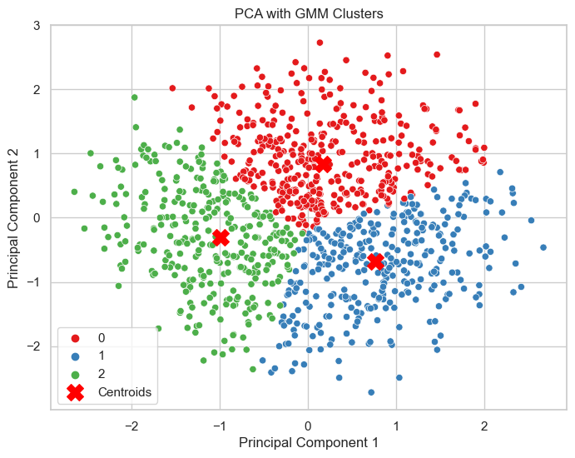
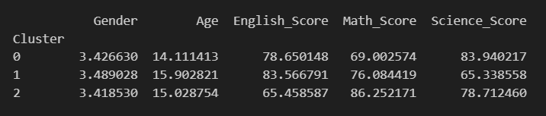
Model Building - GMM clusteringOptimal k with PCA
I will now do k-cluster of 3 with GMM clustering and PCA data:

Slide 16
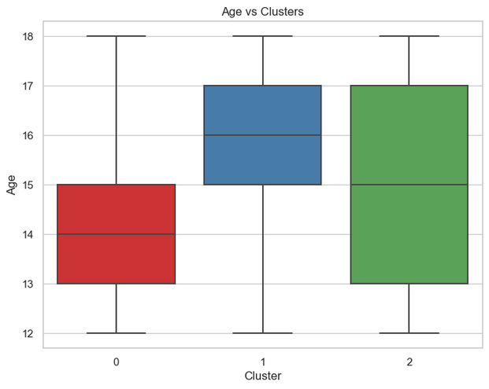
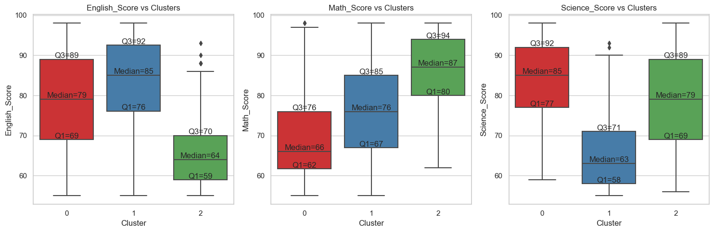
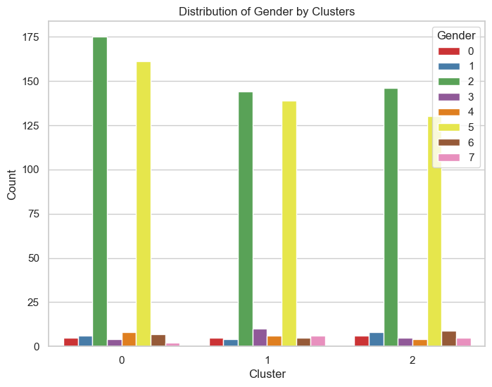
Model Building - Visualizing
Age and cluster:
Score and cluster:
Gender and cluster:
Cluster 0:
- Mix of males and females
- Age range of 13-15
- English score of 69-89 with a median of 79
- Math score of 62-76 with a median of 66
- Science score of 77-92 with a median of 85
Cluster 1:
- Mix of males and females
- Age range of 15-17
- English score of 76-92 with a median of 85
- Math score of 67-85 with a median of 76
- Science score of 58-71 with a median of 63
Cluster 2:
- Mix of males and females
- Age range of 13-17
- English score of 59-70 with a median of 64
- Math score of 80-94 with a median of 87
- Science score of 69-89 with a median of 79

Slide 17
Cluster Evaluation
Cluster 0:
This cluster has a average gender encoding of 3.4, indicating a potential mix of multiple genders such as male(5) and female(2) and others. The average age is around 14 years old. In terms of academic performance, students in this cluster have relatively high English and Science scores compared to their Math scores. This cluster might represent students who excel in language and science subjects but struggle relatively in mathematics.
Cluster 1:
Students in this cluster have a slightly higher average age compared to Cluster 0 of around 16. The gender encoding is around the same. In terms of academic performance, this cluster has the highest average scores in English, followed by Math and then Science. This indicates that students in this cluster perform well overall but may have a stronger performance in English compared to other subjects.
Cluster 2:
This cluster has a similar average gender encoding to Cluster 1 and a slightly lower average age than cluster 1. In terms of academic performance, students in this cluster have the highest average scores in Math, followed by Science and then English. This suggests that students in this cluster excel in mathematics and science subjects but may have a relatively lower performance in English.

Slide 18
Cluster Evaluation
As for which cluster of students needs more attention, it depends on the specific context and goals of our attention.
Age Range: Cluster 1 has the highest age range (15-17), which may indicate that these students are approaching important stages such as college applications or entering the workforce.
Academic Performance:
If we consider English scores as a primary factor, Cluster 2 might need more attention as they have the lowest average English score among all clusters.
If we consider Math scores as a primary factor, Cluster 0 might need more attention as they have the lowest average Math score among all clusters.
If we consider Science scores as a primary factor, Cluster 1 might need more attention as they have the lowest average Science score among all clusters.
If the goal is to balance the performance across all subjects, then attention might be needed for clusters showing a significant disparity between subjects. For example, Cluster 0 excels in Science but has slightly lower scores in Math and Science, so efforts could be made to improve their performance in these areas.

Slide 19
Groups to focus on:
With clustering, we have successfully grouped the students into multiple clusters so that we can cater needs for different students. I resulted in having clusters 3 in total.
My clusters are a mix of female or male with the other genders taking a minority each time due to the small number of them. All my clusters have similar characteristics such as being good or bad at certain subjects. Apart from cluster 2, all other clusters have similar age groups such as being either older or younger, with cluster 2 being a mix of both age groups.
Of all clusters, the cluster I would like to focus on the most are clusters 0. Considering the above analysis, Cluster 0 appears to require more attention due to the lower median scores in English and Math, as well as the younger age range, which presents an opportunity for early intervention to address any academic challenges before they progress further in their education.
After cluster 0, the next important cluster is cluster 1. This might be because they comprises older students and likely nearing the end of high school or preparing for higher education or the workforce. Interventions for this cluster may focus on strengthening mathematical skills to ensure readiness for college or career paths that require strong quantitative abilities.
After Cluster 1, the next is cluster 2. Cluster 2 is the least important as they are spanning a wider age range, they are covering both early and late high school years. They only require help to ensure well-rounded academic proficiency across all subjects which means that they are able to cope well.

Slide 20



THANK YOU!
THE END

